Slide 1
Basic switch configuration
Switch L 2 & l3

Slide 2
Basic command
Enable //enter to user mode
Conf t // enter to configuration mode

Slide 3
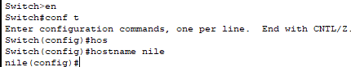
Host name command
Open CLI:
Switch>enable
Switch#conf t
Switch(config)# hostname ……..
Hostname change from switch to nile

Slide 4
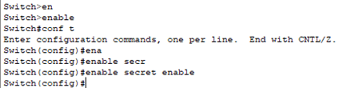
Secret password command
Switch(config)#enable secret ……
……. is the place to inter password

Slide 5

Console password command
Switch(config)#line console 0
Switch(config-line)#password ……..

Slide 6

Configure Telnet password
Switch(config)# line vty 0 15
Switch(config-line)#password telant
Switch(config-line)#login

Slide 7

Configure Management IP
The management IP of Switch is usually assigned to the Interface vlan1
Switch(config)# interface vlan 1
Switch(config-if)# ip address 10.10.1.1 255.255.255.0
Switch(config-if)# no shutdown

Slide 8

Define A VLAN
to define a vlan you must be in configuration mode:
Switch(config)# vlan 11
Switch(config-vlan)# name Internet
Switch(config)# vlan 12
Switch(config-vlan)# name Intranet
Switch(config)# vlan 13
Switch(config-vlan)# name Voice

Slide 9
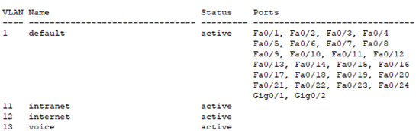
Define vlan
Use the command
Do show vlan brief to show vlan if created
Switch(config)#do show vlan br

Slide 10
Configure Port in access mode
configure port 1,2 to be in vlan 11
Switch(config)# int ran fa0/1-2
Switch(config-if)# switchport mode access
Switch(config-if)# switchport access vlan 11
configure port 3,4 to be in vlan 12
Switch(config)# int ran fa0/3-4
Switch(config-if)# switchport mode access
Switch(config-if)# switchport access vlan 12

Slide 11
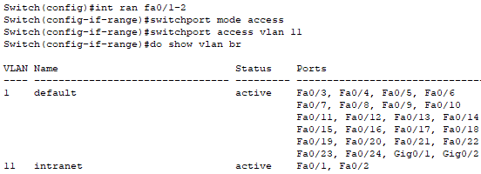
Configure Port in access mode
configure port 5,6 to be in vlan 13
Switch(config)# int ran fa0/5-6
Switch(config-if)# switchport mode access
Switch(config-if)# switchport access vlan 13

Slide 12

Configure Port in Trunk mode
configure port Gigabit 0/1 in trunk mode
Switch(config)# int gi 0/1
Switch(config-if)# switchport mode trunk

Slide 13
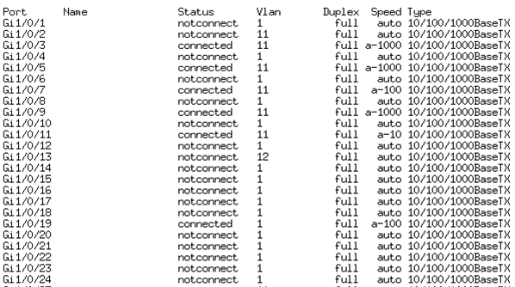
Show interface status
Show interface status in configuration mode :
Switch(conf ig)# do show interface status
Or in user mode:
Switch# show interface status

Slide 14

DHCP configuration
DHCP command:
Switch(config)#ip dhcp pool intranet
Switch(dhcp-config) network 10.10.1.0 255.255.255.0
Switch(dhcp-config) default-router 10.10.1.1
Switch(dhcp-config) dns-server 4.2.2.2

Slide 15

DHCP Exclude some IP’s from the Pool
Switch(config)# ip dhcp exclude-address 10.10.1.1 10.10.1.10
Note:use the Tab key to complete the command

Slide 16

Interface vlans
Switch(config)# int vlan 11
Switch(config-if)#ip address 10.10.1.2 255.255.255.0

Slide 17
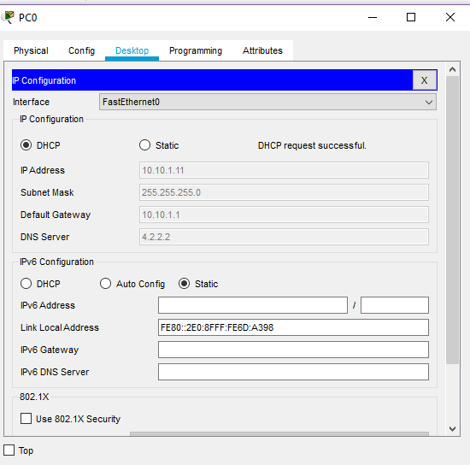
automatic IP from a DHCP server

Slide 18
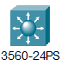
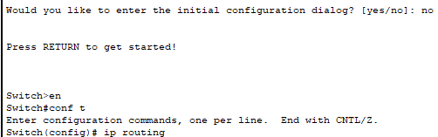
Core switch Layer 3
Basic configuration:
Enable layer 3 or (routing capability ) :
Switch(config)# ip routing

Slide 19

Core switch trunk command
Switch(config)#int gi 0/1
Switch(config-if)#switchport trunk encapsulation dot1q

Slide 20
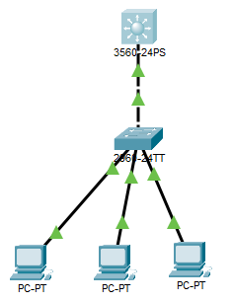
توصيله الامتحان

Slide 21

Mode BY: ALI KAJONKA

